Slide 1
Object Oriented Programming Lab #12 Implementation Of Interfaces
ENGR. SANIYA SARIM

Slide 2
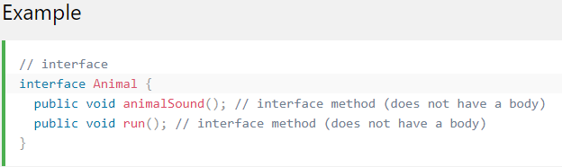
Java Interface
Another way to achieve abstraction in Java, is with interfaces.
An interface is a completely "abstract class" that is used to group related methods with empty bodies:

Slide 3
How to Access Interface Methods
To access the interface methods, the interface must be "implemented" (kinda like inherited) by another class with the implements keyword (instead of extends). The body of the interface method is provided by the "implement" class:

Slide 4
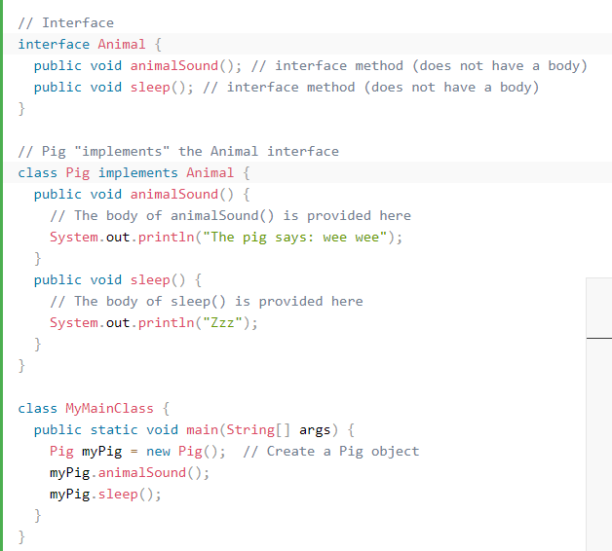
Example of Interface

Slide 5
Notes On Interfaces
Like abstract classes, interfaces cannot be used to create objects (in the example above, it is not possible to create an "Animal" object in the MyMainClass)
Interface methods do not have a body - the body is provided by the "implement" class
On implementation of an interface, you must override all of its methods
Interface methods are by default abstract and public
Interface attributes are by default public, static and final
An interface cannot contain a constructor (as it cannot be used to create objects)

Slide 6
Why And When To Use Interfaces?
1) To achieve security - hide certain details and only show the important details of an object (interface).
2) Java does not support "multiple inheritance" (a class can only inherit from one superclass). However, it can be achieved with interfaces, because the class can implement multiple interfaces. Note: To implement multiple interfaces, separate them with a comma (see example below).

Slide 7
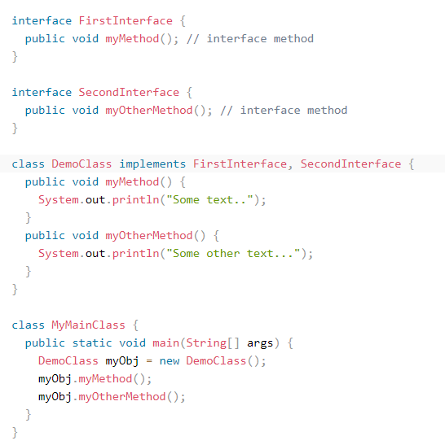
Multiple Interfaces

Slide 8
Output
Some text...
Some other text...

Slide 9
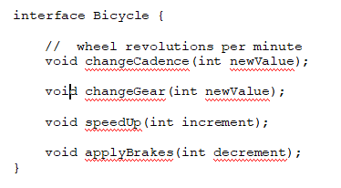
Interface Example of Bicycle
In its most common form, an interface is a group of related methods with empty bodies. A bicycle's behavior, if specified as an interface, might appear as follows:

Slide 10
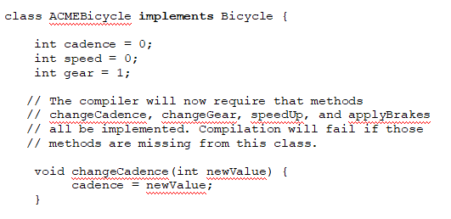
Interface Example of Bicycle
To implement this interface, the name of your class would change (to a particular brand of bicycle, for example, such as ACMEBicycle), and you'd use the implements keyword in the class declaration:

Slide 11
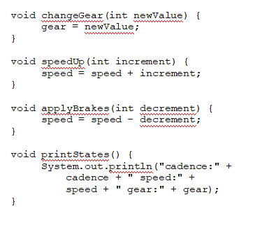
Interface Example of Bicycle

Slide 12
Conclusion
Implementing an interface allows a class to become more formal about the behavior it promises to provide. Interfaces form a contract between the class and the outside world, and this contract is enforced at build time by the compiler. If your class claims to implement an interface, all methods defined by that interface must appear in its source code before the class will successfully compile.

